Slide 1
Image Search Retrieval
Project done by manoj kumar, 17BCE0835
Course: image processing

Slide 2
Introduction
It is a search retrieval system.
Trying to search images based on text or tags, can get very tedious. Sometimes, it could become impossible if there exists no text or tags, or if the images are tagged incorrectly.
we try to retrieve images having similar features, using the background of the image.
For example, if a picture is taken in sunset, then the engine will retrieve other pictures taken during sunset as well.

Slide 3
Problem Statement
First, get the required query image.
Analyze the features of the query image.
Compare the features to that of the images in the dataset.
Retrieve images having similar features.
As we are comparing background features, this will result in the retrieved images having similar background colors.

Slide 4
Procedure
Primarily, we must first index and ready the dataset for use. This is done with the help of the index function. The index program will acquire all the features of the images in the dataset and index them as well. This is also known as readying the dataset.
We use the background RGB colors to analyze the dataset images.

Slide 5
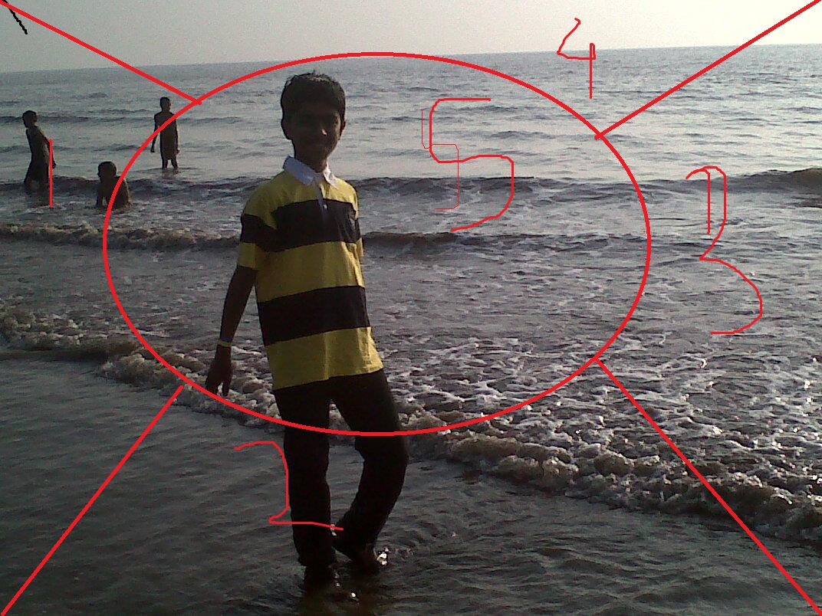
How the algorithm works
For an image, we shall first split the image in this shape. Thus we shall analyze the features of the part 1, 2,3,4. Part 5 is ignored as it is the centre part and needn’t be analyzed. Parts 1,2,3,4 are the image’s background.

Slide 6
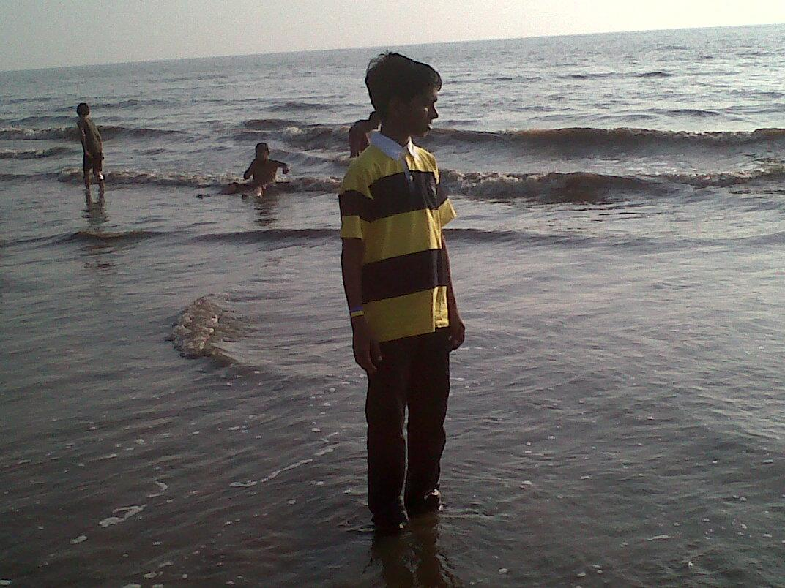
Upon analyzing the image above, one of the possible outputs is

